Slide 1

Programming is fun!
Ray tracing toy by Pier-Antoine Giguère

Slide 2

C++ all the way down
20 years of programming experience
15 years doing C++ professionally
Software tech lead at Vigilance Santé
You get me excited when you talk about…
Code!

Slide 3
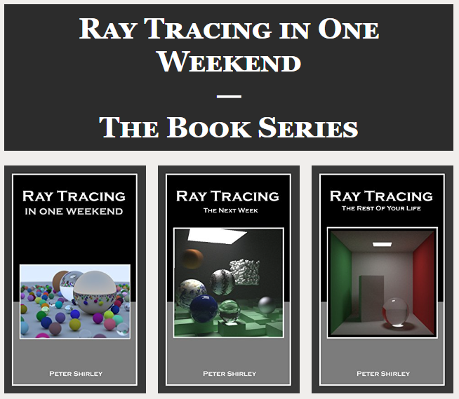
Ray tracing!
Very simple implementation
Iterative steps
https://raytracing.github.io/

Slide 4
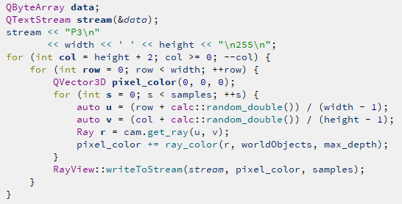
First try!
What the book does:
Write pixels to a data stream and to an image file

Slide 5
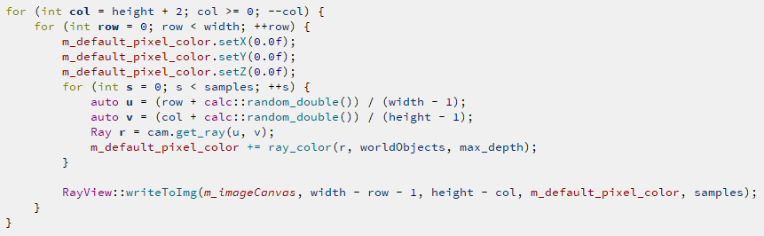
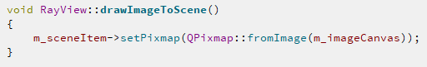
First try!
What I did:
Write to an image
Set pixmap to scene

Slide 6
It worked!

Slide 7
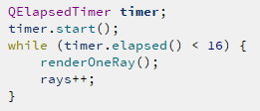
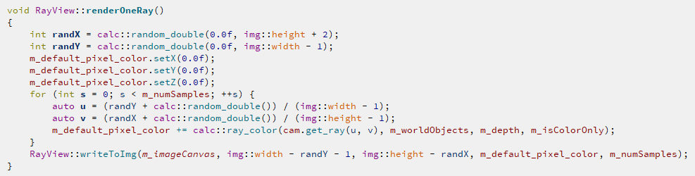
Let’s try in real-time!
For 60 frames per second, one frame will be 16,666 ms
Process one random ray in the scene

Slide 8
Let’s try in real-time!

Slide 9
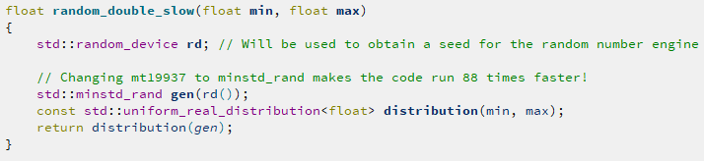

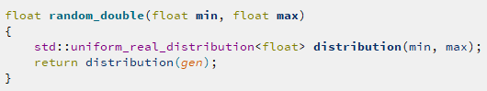
Small optimizations
Evil random generators:
From:
To:

Slide 10
Improvements!

Slide 11
Constexpr random?
https://github.com/tcbrindle/raytracer.hpp
https://github.com/cyyyr/constexpr-Compile-Time-Random

Slide 12



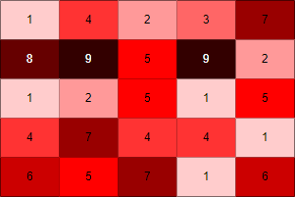
Incremental sampling
Map of samples per pixels

Slide 13

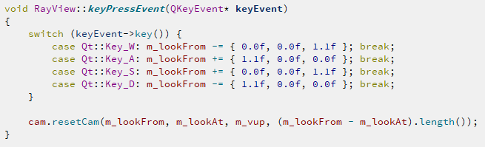
Materials and camera!

Slide 14
Materials and camera!

Slide 15
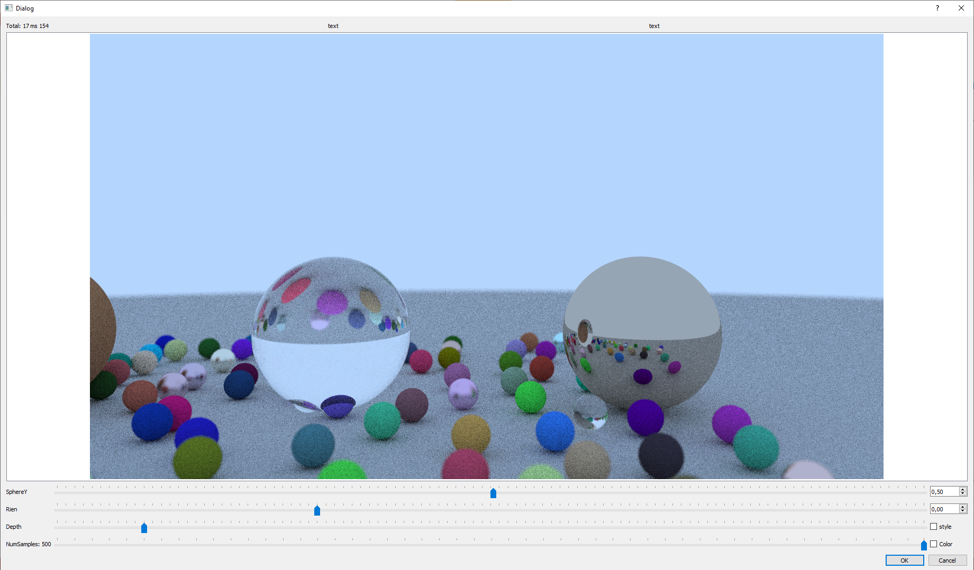
Pushing it!

Slide 16
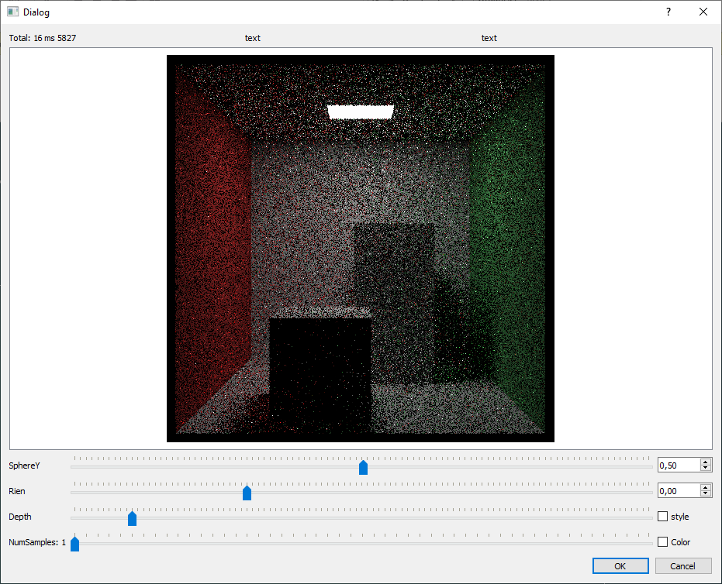
Rectangles and lights!
1 sample per ray
5000 rays per frame

Slide 17
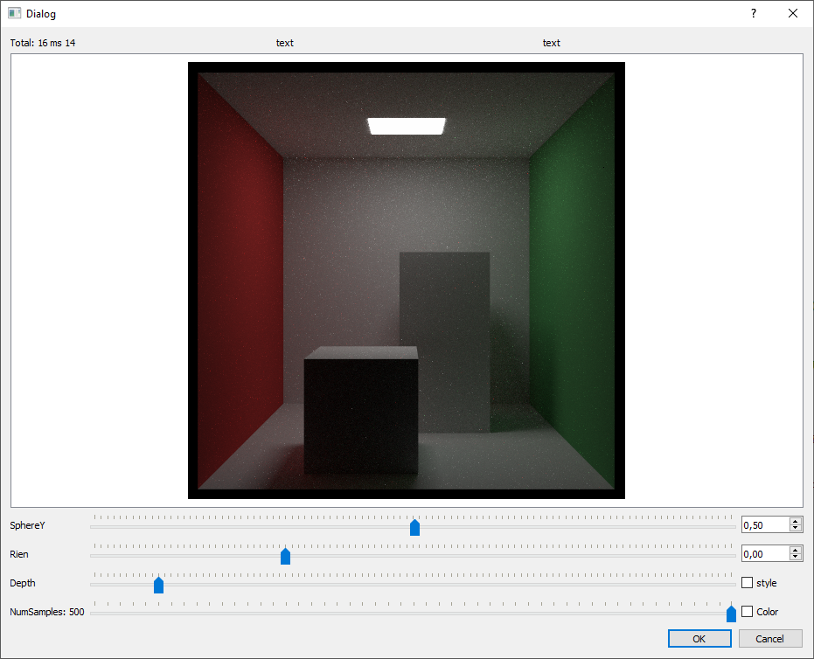
Rectangles and lights!
500 samples per ray
15 rays per frame

Slide 18
Multithread and GPU rendering?
https://codeplay.com/portal/blogs/2020/05/19/ray-tracing-in-a-weekend-with-sycl-basic-sphere-tracing.html
https://github.com/GPSnoopy/RayTracingInVulkan/
https://developer.nvidia.com/blog/accelerated-ray-tracing-cuda/

Slide 19
What surprised me?
Very low memory usage (under 30 megabytes!)
Quality random engines are slow to initialize :P
Temporary variables are very costly (clang vs msvc)
It’s easy, fun and rewarding to build a Ray Tracer!!

Slide 20
What’s next?
Saving the state of the world
Send rays on an existing image to fake depth
Mouse movements
Adding coroutines and C++20 ranges
Ok, maybe multithread some part of it
Maybe "constexpr everything™"

Slide 21

One more thing….
https://github.com/joblobob/ray

Slide 22
Thank you Cpp North Con!

